Slide 1





Egyptian Labor Market Analysis
Quantitative Insights & Actionable Policies from ELMPS 2023 Data
Research Group on Labor Economics and Data Analytics 2025
Mohammed Hamza
Ahmed Abd El Rahman
Rania Mohamed
Eslam Saber
Mohamed Ayman
Zeinab ElSayed
Supervisor: Dr. Amal Mahmoud

Slide 2


Introduction: Why Analyze Egypt's Labor Market?
Context & Importance
Understanding Egypt's labor market dynamics is crucial for economic development, social stability, and achieving sustainable growth. This analysis provides evidence-based insights to guide policy interventions and address structural challenges.
Data-Driven Insights
Using comprehensive survey data to identify key labor market patterns and inequalities
Policy Impact
Translating findings into actionable recommendations for policymakers and stakeholders

Slide 3

Executive Summary

Slide 4
Objectives
Analyze Gender Gap in education and wages
Examine required skills in Egyptian labor market.
Determine Social and health insurance level in different regions.
Measure Job stability level in different regions.

Slide 5

Methodology (Data Sources)
Data
ELMPS 2023:
73,000+ respondents reduced to 13,817

Slide 6
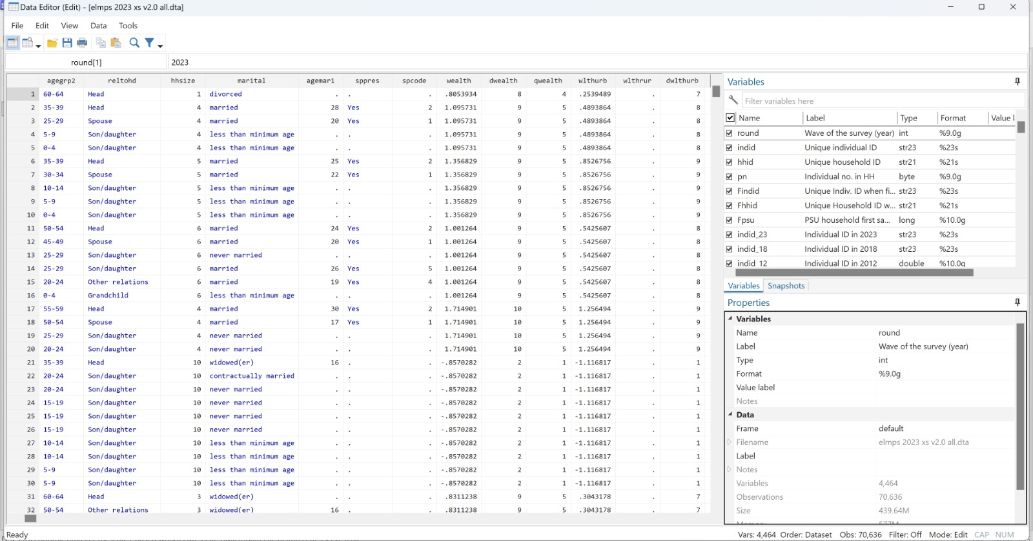
Preprocessing:

Slide 7
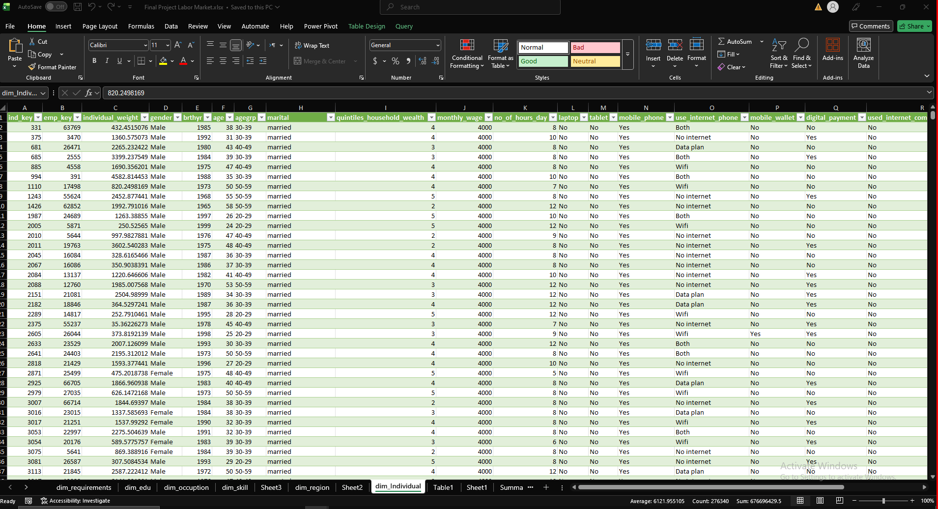
Preprocessing (Continued) :

Slide 8

Background: Key Labor Market Features
Structural Challenges
Informality: 58% lack social insurance
Gender Gap: <20% female participation
Regional Imbalance: 22% urban-rural wage gap

Slide 9
Methodology (Dashboards)
Excel.
Tableau.
SQL.
Python

Slide 10
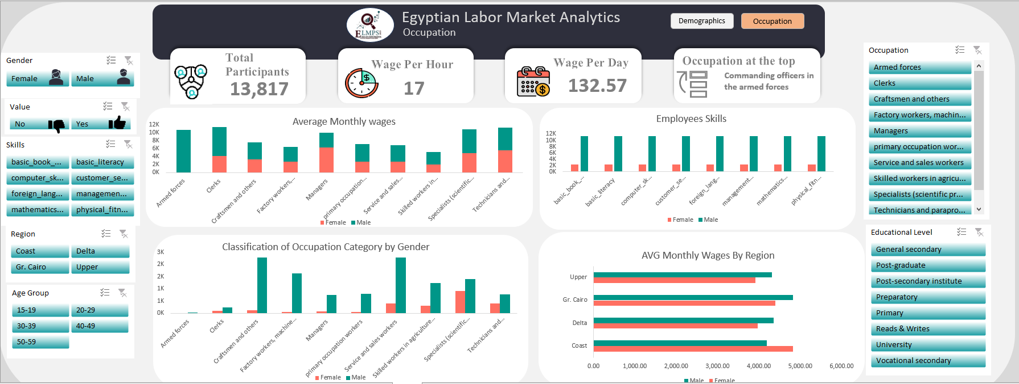
Excel Results

Slide 11
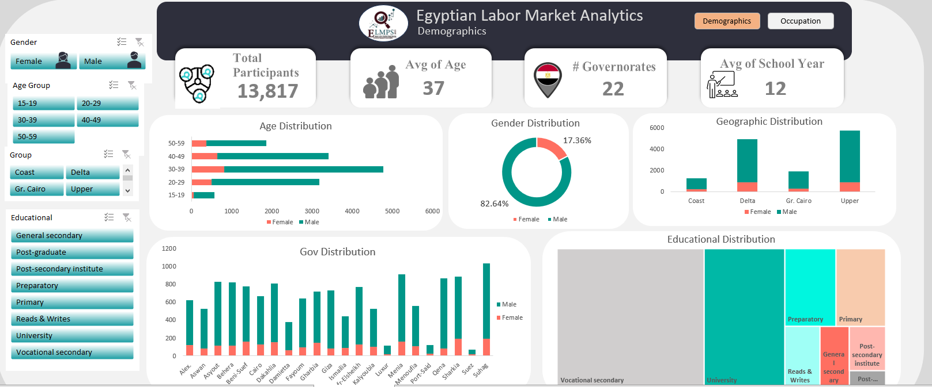
Excel Results

Slide 12
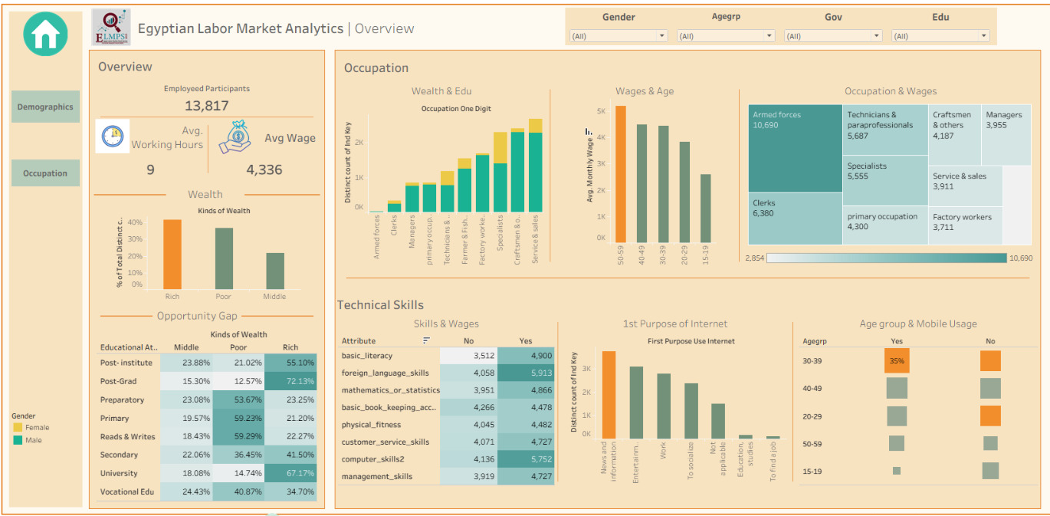
Tableau Results

Slide 13
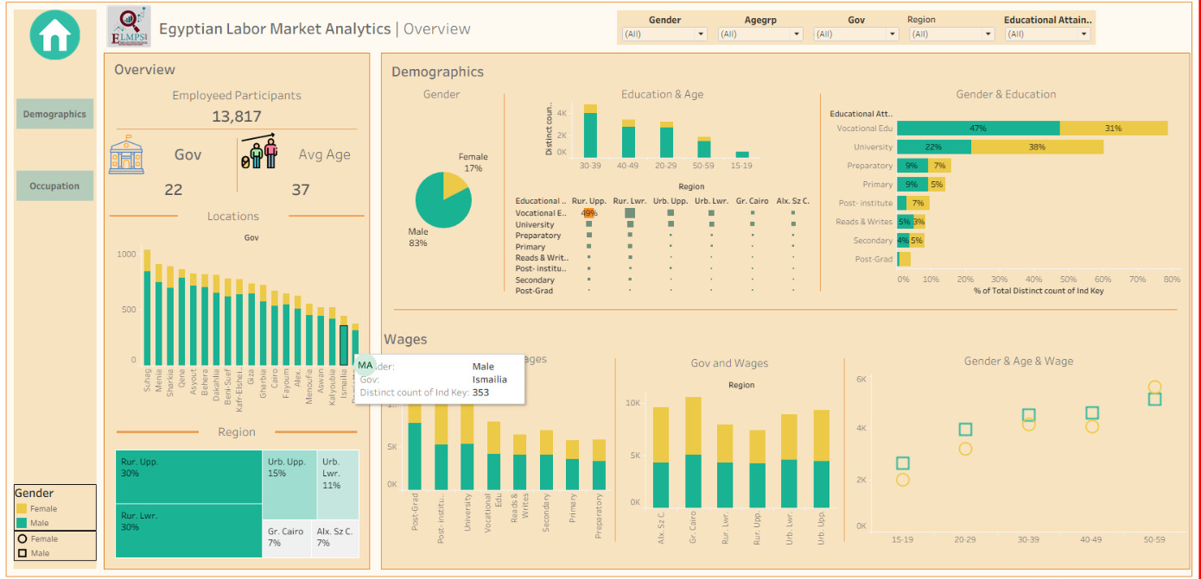
Tableau Results

Slide 14
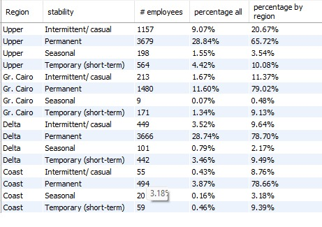
SQL Results

Slide 15
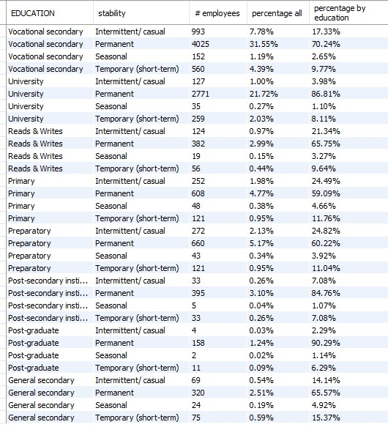
SQL Results

Slide 16
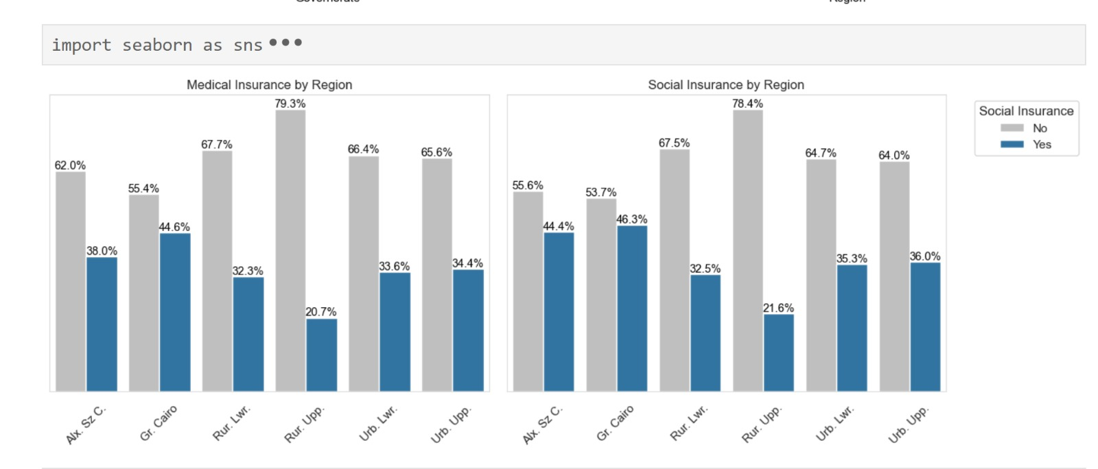
Python Results

Slide 17
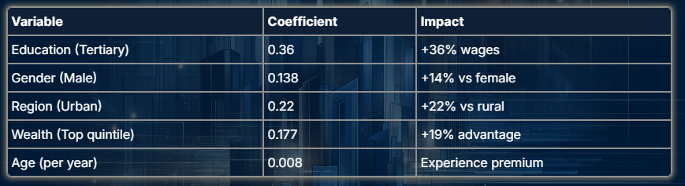
Wage Model (OLS): Key Determinants
Regression analysis reveals significant factors affecting wages in Egypt's labor market

Slide 18
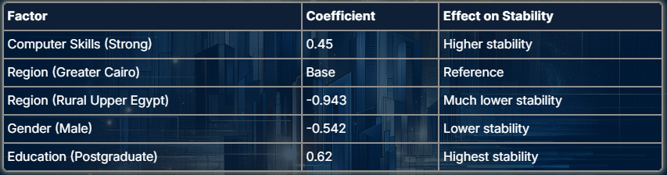
Job Stability Model (Ordered Logit)
Analysis of factors affecting job security and stability in Egyptian labor market

Slide 19
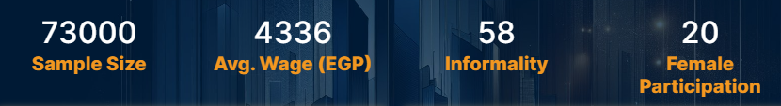
Sample Description & Key Statistics
Regional Gap
22% wage differential between urban and rural areas.
Greater Cairo premium.
Upper Egypt lagging.
Youth Challenge
Education mismatch.
Skills gap.

Slide 20
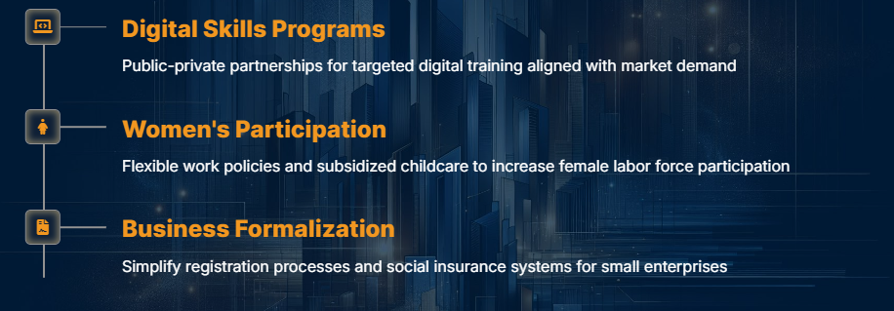
Policy Recommendations

Slide 21
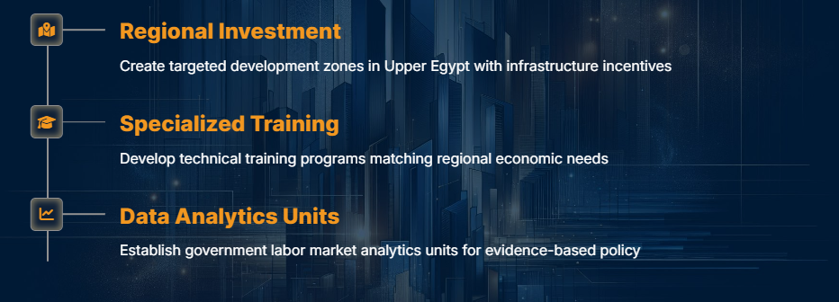
Policy Recommendations (Continued)

Slide 22

Policy Implications & Next Steps
Immediate Actions
Start with digital skills pilot programs
Establish baseline indicators for monitoring
Create inter-ministerial coordination committee
Launch female entrepreneurship initiatives

Slide 23
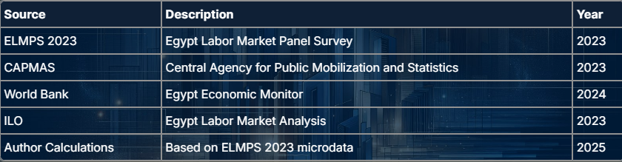
References

